Slide 1
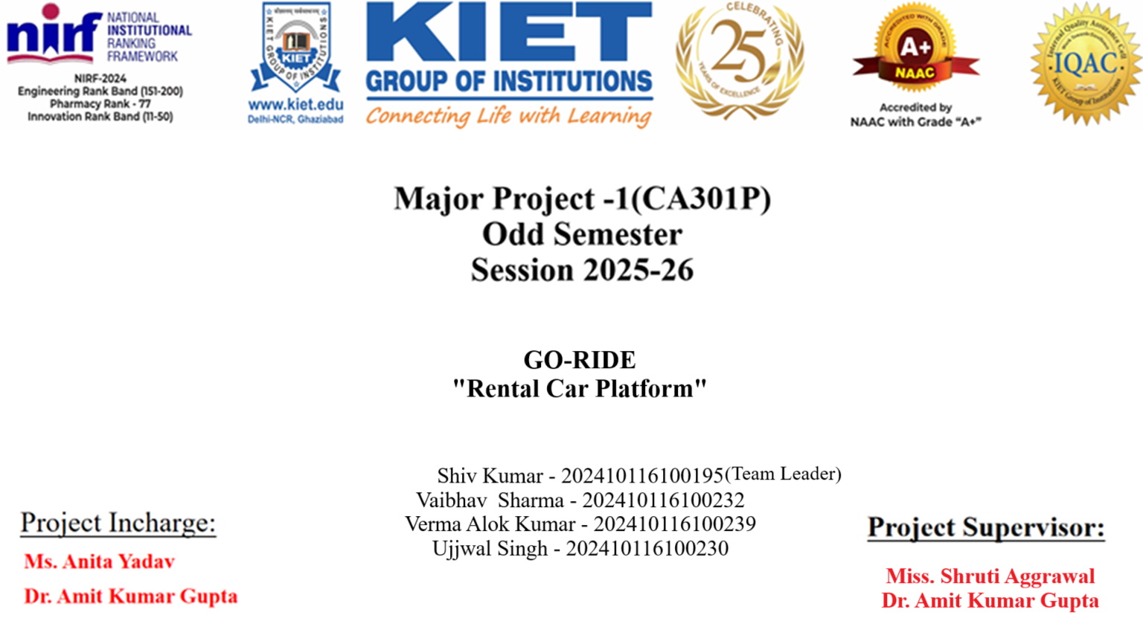
Project Incharge :
Dr. Amit kumar
Mr. Saurabh Chaudhary
Ms. Mahima Tayal
Ms. Shalika

Slide 2
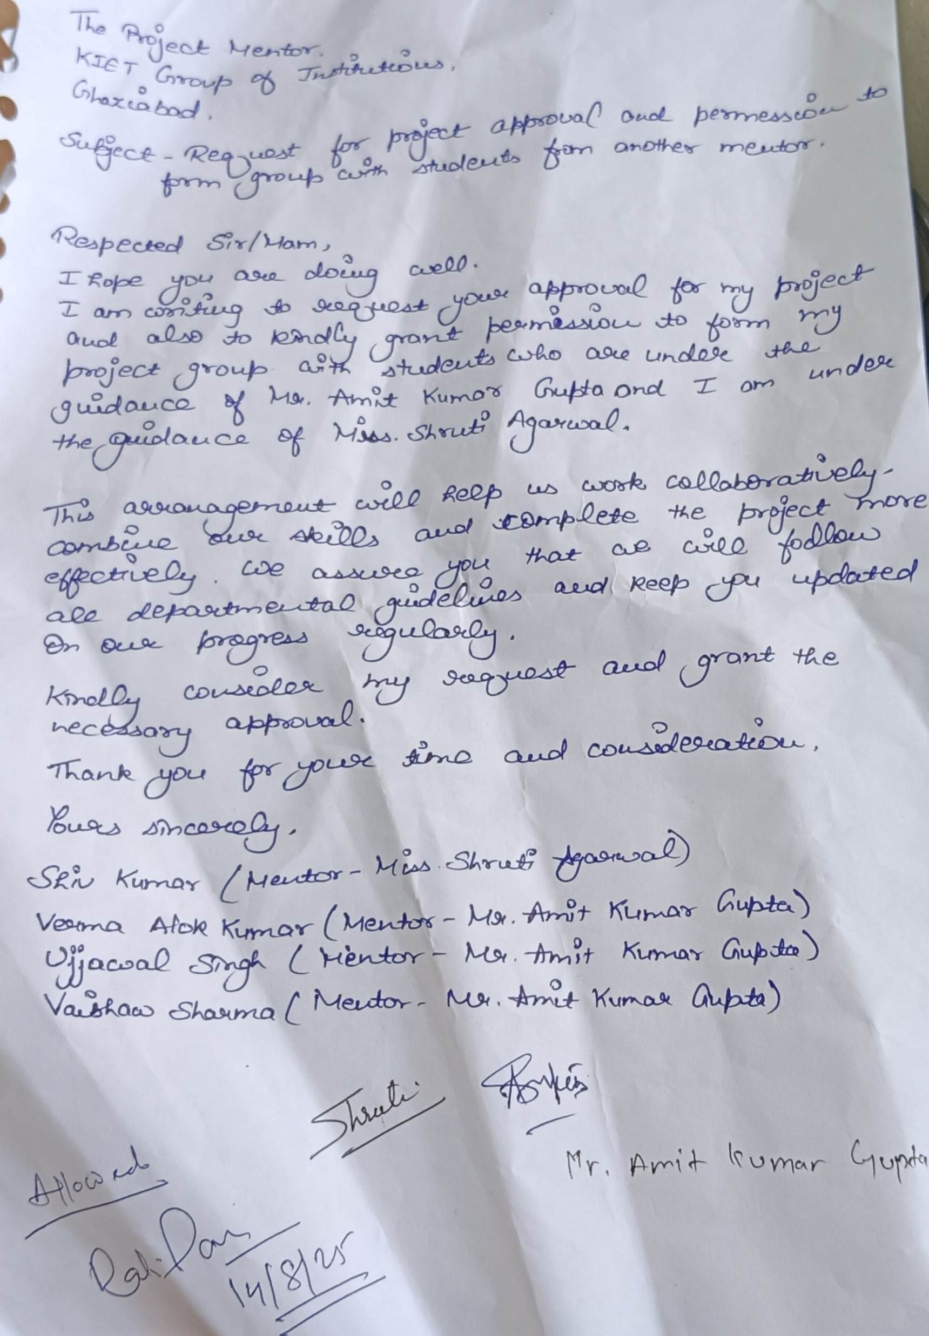

Slide 3
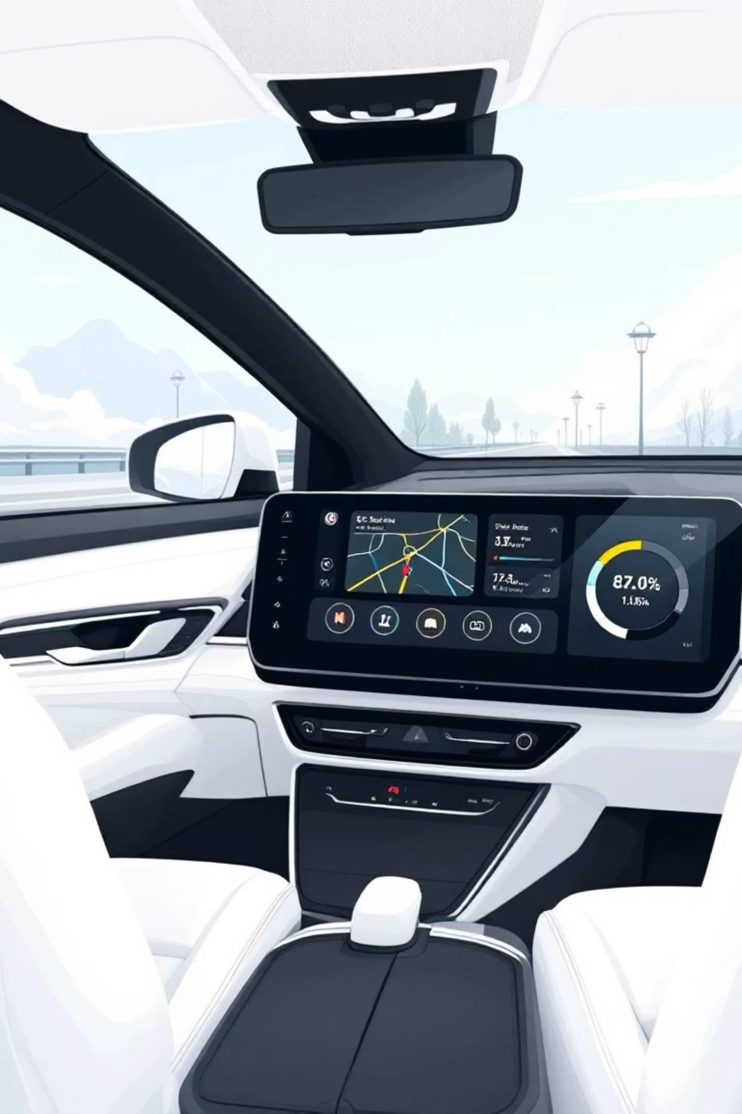

Accelerating Mobility: A Full-Scale Car Rental Platform
Empowering seamless car rental experiences for users, vendors, and administrators.

Slide 4
Problem Statement
• Lack of seamless online booking systems
• High costs and limited accessibility
• Unverified drivers and vehicles

Slide 5



Introduction: Unlocking the Future of Car Rentals
Seamless Experience
Effortless booking and management for all stakeholders.
Full-Scale Solution
Comprehensive modules for users, vendors, and admins.
Scalable & Secure
Robust architecture with advanced security features.
This presentation outlines our innovative platform designed to revolutionise the car rental industry in India.

Slide 6
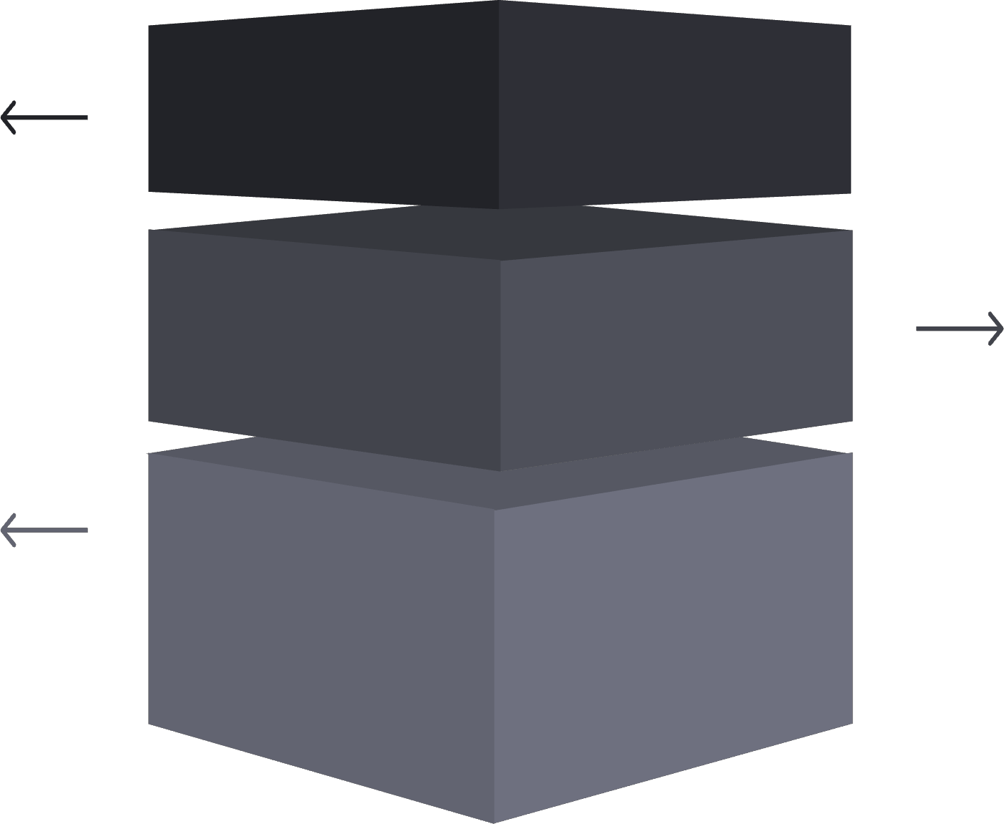
Platform Overview: Core Modules
User Module
Customer booking, search, and payment features.
Vendor Module
Fleet management, availability, and pricing tools.
Admin Module
System control, reporting, and user management.
Our platform is meticulously structured into three interconnected modules, each tailored to the specific needs of its users, ensuring a streamlined and efficient car rental ecosystem.

Slide 7

Technical Architecture: Powering the Platform
Frontend Technologies
React.js (Vite): For a fast, responsive, and dynamic user interface.
Tailwind CSS: For utility-first styling and rapid UI development.
Backend & Database
Node.js : Robust and scalable server-side development.
MongoDB: Flexible NoSQL database for efficient data storage.
Express.js: add middleware to your application.

Slide 8



Security & Authentication: Building Trust
Authentication
Secure and stateless user authentication.
Google Auth
Simplified and secure sign-in experience.
Role-Based Access Control
Granular permissions for different user types.
Prioritising data security and user privacy is paramount, ensuring a trustworthy environment.

Slide 9
Key Features: Enhancing User Experience
Real-time Email Notifications
Instant updates on booking confirmations, cancellations, and other critical alerts, ensuring users are always informed.
Advanced Search & Filtering
Users can easily find their ideal vehicle using comprehensive search options based on car type, price, location, and availability.
Secure Payment Gateway
Integrated with Razorpay for smooth, secure, and reliable online payment processing, supporting various payment methods.
These features are designed to create a seamless and reliable experience for every user.

Slide 10

Admin Module: Comprehensive Control
The Admin module provides a centralised dashboard for complete platform oversight and management:
Vehicle Management: Add, edit, and remove vehicle listings, including details, availability, and pricing.
Vendor Management: Approve or reject vendor applications, manage vendor profiles, and monitor their performance.
Booking Oversight: View, modify, or cancel any booking, and resolve disputes swiftly.
User Administration: Manage user accounts, enforce policies, and monitor platform activity.
This module ensures efficient operation and maintains platform integrity.

Slide 11
Vendor Module: Empowering Providers
Seamless Vehicle Listing & Management
Vendors can effortlessly list their vehicles for rental, subject to admin approval, directly through a dedicated portal. Key capabilities include:
Vehicle Submission: Upload detailed information, photos, and pricing for their fleet.
Approval Workflow: All new vehicle listings undergo an approval process by administrators to maintain quality and compliance.
Availability Management: Update vehicle availability in real-time, preventing overbooking and ensuring accurate information for users.
Booking Tracking: Monitor incoming bookings, review rental history, and manage their rental operations effectively.
This module ensures vendors have the tools needed to maximise their reach and revenue.

Slide 12


Future Roadmap: Continuous Innovation
Mobile Applications
Native iOS and Android apps for on-the-go access.
Enhanced Analytics
Deeper insights for admins and vendors.
IoT Integration
Smart vehicle access and telematics.
AI-Driven Recommendations
Personalised vehicle suggestions for users.
Our commitment to innovation will drive continuous platform evolution.

Slide 13

Conclusion: Your Partner in Mobility
This full-scale car rental platform is more than just a booking system; it's a comprehensive solution built for the future of mobility.
Robust and scalable architecture.
Enhanced security and user experience.
Empowering tools for all stakeholders.
A clear roadmap for future innovation.
Let's drive the future of car rentals, together.

Slide 14
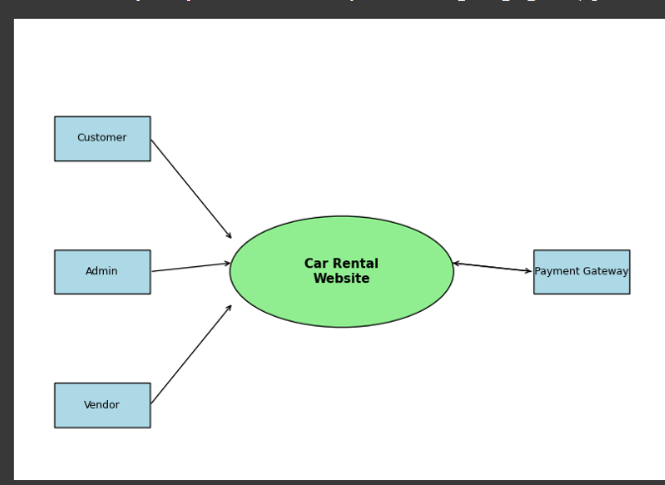
Level 0

Slide 15
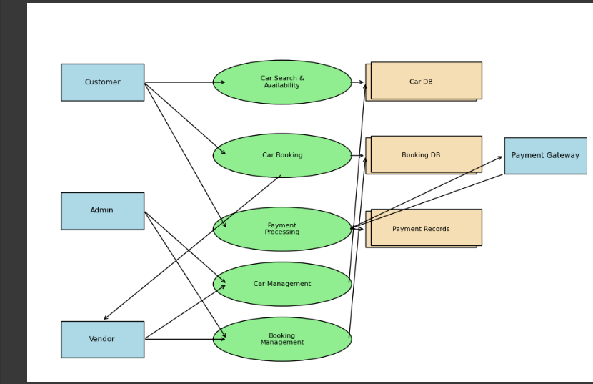
Level 1

Slide 16
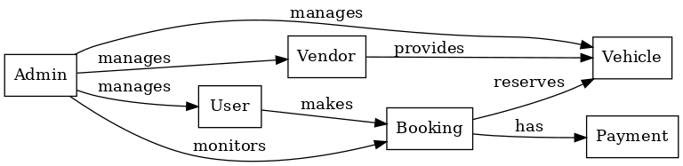

Slide 17


